Slide 1
Digital Portfolio
T.sanajy
STUDENT NAME:
REGISTER NO AND NMID:
DEPARTMENT:
COLLEGE: COLLEGE/ UNIVERSITY
241330218025210 39/asanm30224133021802521039
computer science department
Dr.R.K.S College of arts and science College Indili,Kallakurichi district. / Annamalai university

Slide 2
PROJECT TITLE
1.Admission form of college

Slide 3


AGENDA
Problem Statement
Project Overview
End Users
Tools and Technologies
Portfolio design and Layout
Features and Functionality
Results and Screenshots
Conclusion
Github Link
3/21/2024 Annual Review

Slide 4

PROBLEM STATEMENT
Many colleges still rely on manual admission forms, which cause frequent errors and loss of important student data. This traditional method also takes more time and creates difficulties for both students and staff.
A web-based admission form is required to collect student details and generate a unique form number. It should validate age, mobile number, and email, provide a preview before submission, and show a confirmation after successful submission to make the process accurate and efficient.

Slide 5

PROJECT OVERVIEW
The Admission Form Project is a web-based application designed to simplify the student admission process in colleges. Instead of relying on manual paper forms, this system allows students to fill out their details online, ensuring accuracy and saving time for both students and staff.
The project includes features such as auto-generation of a unique form number, input validation for age, mobile number, and email, a preview option before submission, and a confirmation page after successful entry. This digital solution makes the admission process faster, error-free, and more user-friendly

Slide 6

WHO ARE THE END USERS?
The primary end users of this system are students who wish to apply for admission to the college. They will use the online admission form to enter their personal, academic, and contact details, preview the data, and confirm the submission easily.
The secondary end users are the college staff and administrators, who will manage the submitted forms, verify student details, and process admissions efficiently. This reduces manual work, improves accuracy, and makes the admission process smoother for the institution.

Slide 7

TOOLS AND TECHNIQUES
This project uses HTML, CSS, and JavaScript as the main tools to design and develop the admission form interface. HTML structures the content, CSS provides styling for a clean layout, and JavaScript adds validation and interactivity to ensure correct data entry.
For techniques, the project applies form validation methods (checking age, mobile number, and email), auto-generation of unique form numbers, and a confirmation/preview system before submission. These techniques help improve accuracy, save time, and make the admission process user-friendly.

Slide 8
POTFOLIO DESIGN AND LAYOUT
The portfolio design of this project is created using a clean and professional layout, focusing on simplicity and readability. The interface uses structured sections such as Home, About, Admission Form, Contact, and Help, making navigation easy for users. The color scheme is consistent, with a neat combination of dark headers and light content areas for better visibility.
The layout follows a card-based design where each section (About, Analysis, Employee Profile, etc.) is displayed inside a styled card for clarity. Proper headings, spacing, and highlight colors are used to improve user experience. The responsive layout ensures that the portfolio looks well-organized on both desktop and mobile devices.
8

Slide 9
FEATURES AND FUNCTIONALITY
The Admission Form Project provides key features such as online admission form filling, auto-generation of form numbers, real-time input validation (age, mobile number, email), and preview before submission. These features ensure that students can submit their details accurately without errors.
The functionality includes form submission with confirmation messages, secure data storage for future reference, and easy access for administrators to review applications. The system also works on both desktop and mobile devices, making it flexible and user-friendly for all end users.

Slide 10
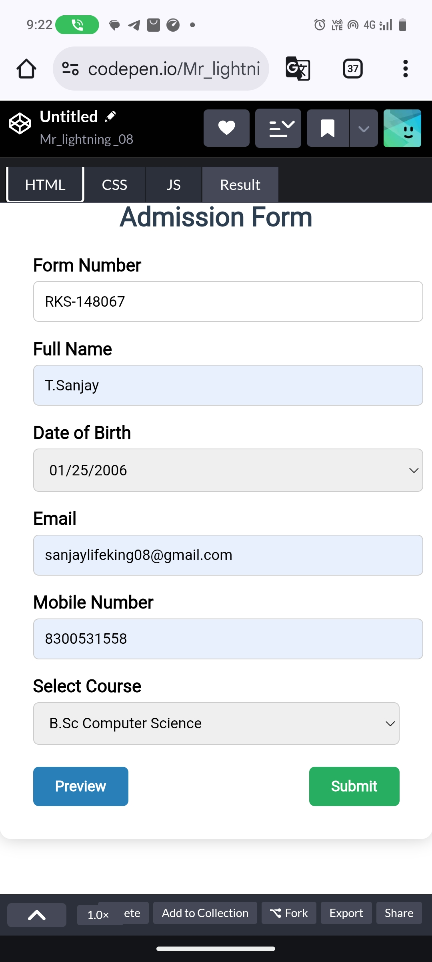
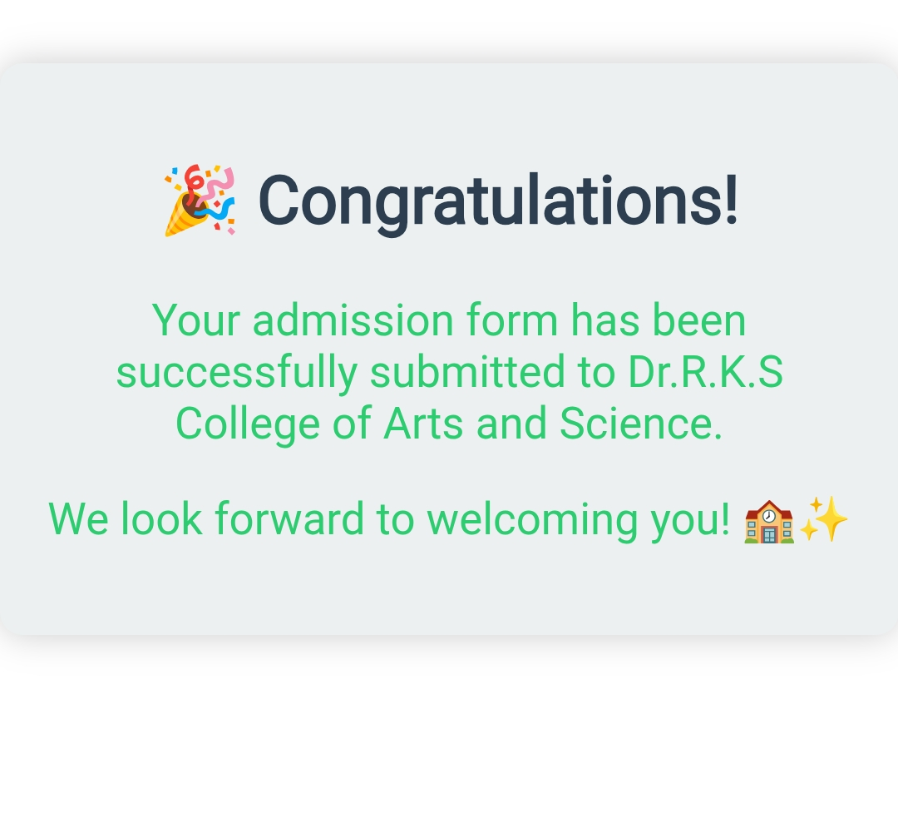

RESULTS AND SCREENSHOTS
3/21/2024 Annual Review
10

Slide 11
CONCLUSION
The Admission Form Project successfully replaces the traditional manual admission process with a digital and efficient system. By using HTML, CSS, and JavaScript, it provides a simple, user-friendly platform for students to submit their details securely and accurately.
This project reduces errors, saves time, and improves data management for the college administration. Overall, it enhances the admission process by making it more reliable, accessible, and convenient for both students and staff.
11

